Slide 1

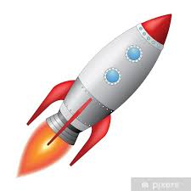
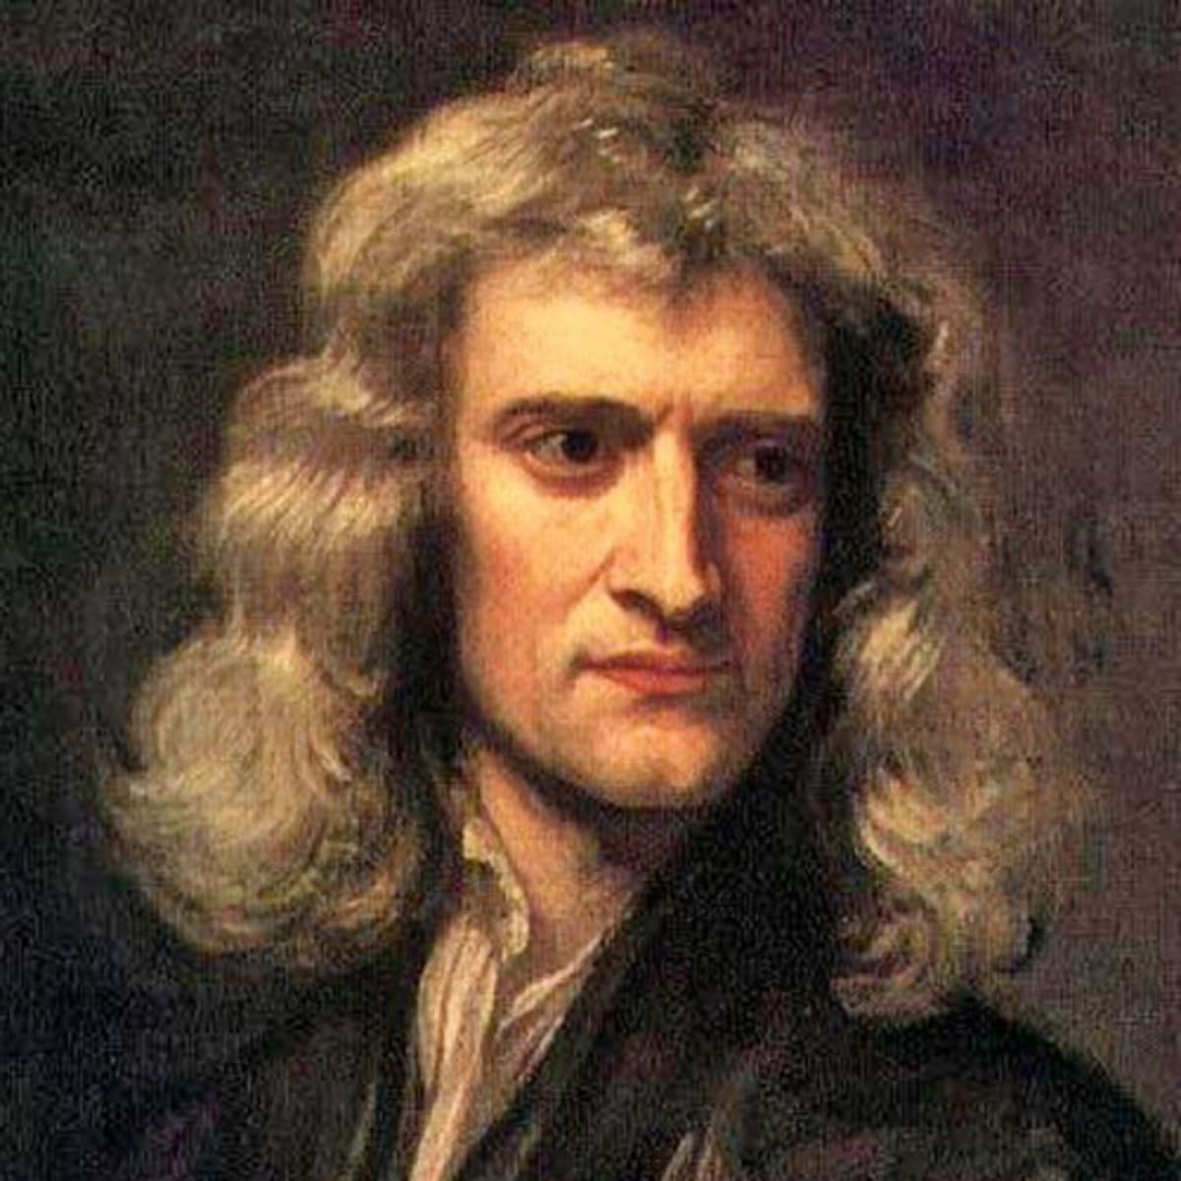
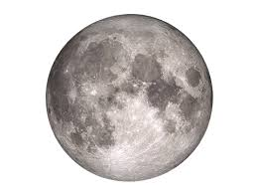
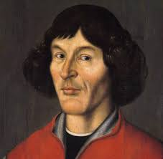
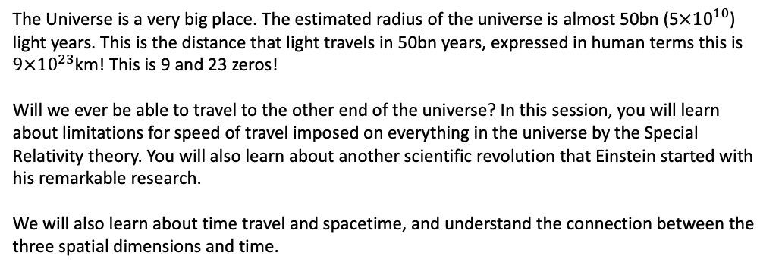
解密神奇的宇宙 Unlocking the secrets of the Universe
Session 2.1: from Einstein to Hawking
Hello Universe!
Today’s VIP guest list
The Universe is a very big place. The estimated radius of the universe is almost 50bn (5$×{10}^{10}$) light years. This is the distance that light travels in 50bn years, expressed in human terms this is $9×{10}^{23}$km! This is 9 and 23 zeros!
Will we ever be able to travel to the other end of the universe? In this session, you will learn about limitations for speed of travel imposed on everything in the universe by the Special Relativity theory. You will also learn about another scientific revolution that Einstein started with his remarkable research.
We will also learn about time travel and spacetime, and understand the connection between the three spatial dimensions and time.
Isaac Newton
Session objectives
Recap relativity of motion and inertial reference frames
Understand the basic idea behind Special Relativity
Discuss time dilation and length contraction as consequences of Special Relativity
Ponder the philosophical implications of Special Relativity
Come up with ways to travel faster than light and break Relativity Theory
Key terms
Special Relativity
狭义相对论
time dilation
时间变慢
speed of light
光速
inertial frame of reference
不变惯性参考坐标系
Length contraction
长度变短
Relativistic mass
相对论性质量

Slide 2

解密神奇的宇宙 Unlocking the Secrets of the Universe
Light speed
光速
Speed that light travels through vacuum with (= 300,000,000 m/s)
Heliocentrism
The model of the Solar System where the Sun is in the middle, and planets are orbiting around it.
Ockham's razor
奥卡姆剃刀
The “rule of thumb” that tells us that if we have 2 answers to the same problem, we should pick the simpler one.
Sometimes Ockham's razor is formulated as: “the simplest solution is the best one”
Scientific revolution
科学革命
A time when due to e.g. new evidence, new experiments, new proofs etc. a major paradigm in science is proven to be wrong. For example, Aristotelean mechanics was overturned （颠覆）by Newton’s mechanics.
Interstellar travel
If we imagine that humans have found a planet that is habitable to us “only” 4 light years away, how long does it take light to get there?
When we observe this planet via a telescope, and we observe an alien waving their hand at us, “when” did they wave their hand?
1
Relative speeds
If we are sitting on train and watching the view from the window, if might seem to use sometimes that it is not the train moving, but actually the world outside the window is moving.
From Earth’s surface, it looks like the Sun is rotating around Earth. But if we travel to the Sun and look around, we will actually think that it is the planets that are moving.
So, what is moving, and does it make a difference?
Copernicus vs. Church
In middle ages, it was common to assume that the Earth is in the center of the Solar system (or even: in the center of the universe). The Catholic Church supported this idea, as it made Earth in some way “special”, as “God’s creation”.
However, scientists found it extremely difficult to describe the motion of objects around Earth in this system.
All this changed when Nicolaus Copernicus proposed a new model, where the Sun was “fixed” in the middle if the Solar system, with planets orbiting around it.
This model was much simpler than the original model.
Which model is “correct” and why?
Important term: Ockham’s Razor （奥卡姆剃刀）
The notion (or “rule of thumb”) that dictates we always pick the simplest solution to the given problem.
JinJin STEM Academy

Slide 3

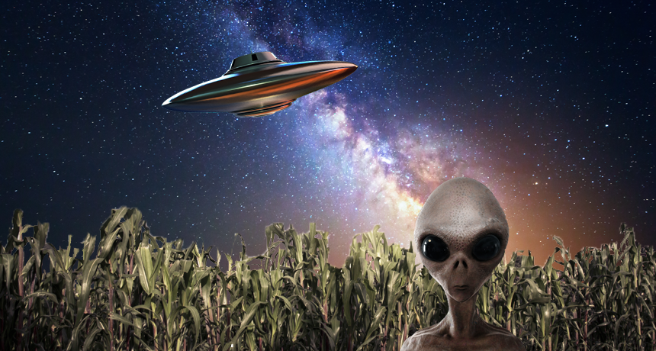
解密神奇的宇宙 Unlocking the Secrets of the Universe
Frame of reference
坐标系
A system in which we describe things (e.g. position and movement of bodies)
Inertial frame of reference
不变惯性坐标系
A frame of reference that is not accelerating
Newton’s 1nd Law
If there is no forces acting, everything is in rest, or moving with constant speed with respect to you.
Hello world, we are just passing by!
Imagine we are traveling through space in our spaceship that can travel very fast, approximately 50% of the speed of light.
We are passing by a new planet, and as we do, the aliens living there are watching us carefully and taking measurements to test their new theory concerning light, speed, relativity and the universe.
From the aliens’ point of view, what is your speed?
If your spaceship has a front light attached to its cockpit, and you turn it on (to be able to spot asteroids and space dust in your way as you steer through space), from the aliens’ perspective, what is the speed of the light you are using? What is this speed from your perspective?
You launch another, smaller unmanned ship traveling in the same direction, to check the route ahead of you. You launch it with the speed of 70% of the speed of light. From your perspective, how fast is this vehicle traveling with? From aliens’ perspective, how fast is it moving?
1
JinJin STEM Academy

Slide 4

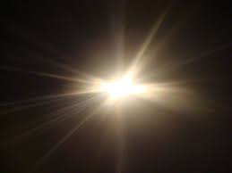
解密神奇的宇宙 Unlocking the Secrets of the Universe
Einstein chasing light
By the end of 19th century, scientists have already managed to describe light as an oscillating wave.
Different wave lengths (different oscillation frequencies) correspond to different “types” of light. For example, different colors are just light of different frequencies. Microwaves used in microwave ovens are also different “colors” of the same light.
In late 19th c., 16-year old Albert Einstein asked himself: what if I travel with the speed of light, next to a light wave: according to relativity of motion, I should see light “frozen” in place (so really, it will just be a frozen wave not oscillating anymore)
To Einstein, this seemed counterintuitive.
Do you also think it’s counterintuitive to imagine a “frozen” wave?
What is “intuition”?
1
The key postulates of Special Relativity
Laws of Physics are the same in all inertial reference frames.
Speed of light is CONSTANT regardless of what reference frame you are observing it from.
Re-considering spaceship measurements
If we assume that the speed of light is constant in ALL reference frames, what does this mean for our calculations for speed of light in different reference frames, as seen from our spaceship and as seen from the alien planet?
JinJin STEM Academy

Slide 5
解密神奇的宇宙 Unlocking the Secrets of the Universe
Re-considering spaceship measurements
If we assume that the speed of light is constant in ALL reference frames, what does this mean for our calculations for speed of light in different reference frames, as seen from our spaceship and as seen from the alien planet?
JinJin STEM Academy

Slide 6
解密神奇的宇宙 Unlocking the Secrets of the Universe
Time dilation
时间变慢
When we travel with high speed, from our perspective time flows slower than from the perspective of an outside observer fixed with respect to us.
Length contraction
长度变短
When we travel with high speed, from our perspective our length in the direction of motion is longer than from the perspective of an outside observer.
Relativistic mass
相对论质量
The mass objects moving with high speeds have, as consequence of relativity theory. The mass will increase for high speeds.
Speed of light: the universal constant of the universe
The consequence of the second postulate of the Special Relativity theory is that speed of light enjoys a “special status” in the universe
Space and time adjust to make sure that the speed of light remains unchanged.
Time dilation
Imagine we are looking in the mirror aboard our spaceship.
What is the distance that the light travels from our perspective, from our face to the mirror and back?
What is the distance that the light travels from aliens’ perspective, from our face to the mirror and back?
What is the time it takes light to travel this distance from both frames of reference?
If we assume speed of light cannot change, what does this mean for your two reference frames? What should the time equal, as observed by yourself, and as observed by the aliens?
***Now, what will be the length of your spaceship, as observed by you, and as observed by aliens?
JinJin STEM Academy

Slide 7

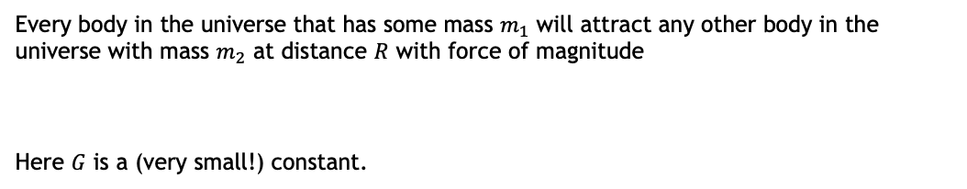
解密神奇的宇宙 Unlocking the Secrets of the Universe
Relativistic Mass
Every body in the universe that has some mass $m_{1}$ will attract any other body in the universe with mass $m_{2}$ at distance $R$ with force of magnitude
Here $G$ is a (very small!) constant.
Food for thought
What is $R$? How is it measured?
What happens when $R=0$? Is there a paradox here?
Food for thought
What does relativistic mass equation imply for space travel?
Can we travel faster than light?
JinJin STEM Academy

Slide 8
解密神奇的宇宙 Unlocking the Secrets of the Universe
Session Summary
Special relativity tells us that time and space look different depending on where the observer is sitting. Space and time are in this way relative
Special relativity tells us that space and time “adjust” themselves to keep the speed of light constant.
Special relativity also tells us that our mass will increase if we travel with very high speed. This implies that traveling with speed of light is impossible, unless our mass is reduced to 0!
Ponder before next class
Does Special Relativity mean that we can never “travel faster than light”?
By how much would your spaceship’s mass increase, if you travelled with speed equal to 10%? 50% of speed of light? What if you managed to reach 70% of the speed of light?
If you stay on Earth and your twin sister leaves on a space mission traveling in a spaceship with speed = 50% speed of light, if she comes back after 20 years, who will be older and by how much?
Can you travel with speed of light?
JinJin STEM Academy

